Slide 1

No Space Is Safe
Charlie Jensen
UCLA Extension Writers’ Program

Slide 2
Agenda & Session Goals
Goal: to develop an awareness of classroom management techniques in the context of group dynamics, while exploring tools to help bring students together.
Introductions (prior to presentation)
What do we mean by “safe space”?
Theory of group formation
Alternatives to “safe space” guarantees
Toolkit presented by Martín Hernández, Senior Program Associate, Los Angeles County Department of Arts and Culture
Q&A

Slide 3
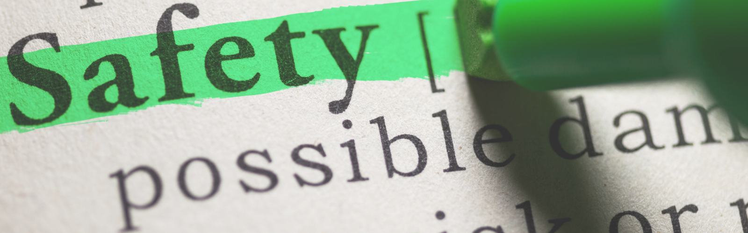
What Do We Mean by Safe Space?

Slide 4
“
a place or environment in which a person or category of people can feel confident that they will not be exposed to discrimination, criticism, harassment, or any other emotional or physical harm.
“
(Oxford Dictionary)

Slide 5
Is the Writing Workshop Safe?
Is it free of criticism?
Is it free of discrimination?
Is it free of harassment?
Is it free of harm?
In what ways must students make themselves vulnerable in order to thrive in a workshop environment?

Slide 6
What do we risk
when we assure students
they’re in a safe space,
but they experience harm?

Slide 7
Group Formation Dynamics
Life cycle of a community
Forming
Storming
Norming
Performing
Adjourning
Communities go through observable transitions as they develop, from the honeymoon-like Forming stage to the contentious Storming stage.
Since we know these shifts are normal, can we take steps to ensure a smooth passage?
One big factor we want to look at here is how conflict is handled and resolved.
From Tuckman’s Stages of Group Development

Slide 8
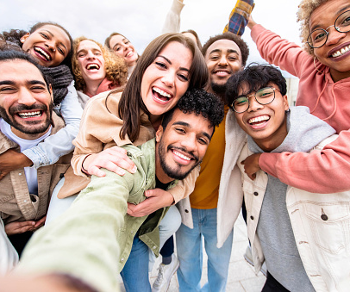
Forming Stage: Weeks 1-4
Feelings & behaviors
Politeness
Avoiding controversy and conflict at all costs
Seeking group purpose
Optimism/excitement
Anxiety/suspicion
Trying to connect with others
Desire for acceptance/inclusion

Slide 9
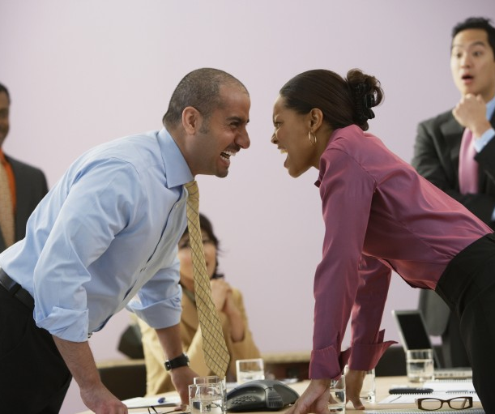
Storming Stage: Weeks 2-7
Feelings & behaviors
Overt/Covert disagreement
Vying for leadership/power
Defensiveness/Dismissiveness
Digging in or Backing Out
Jealousy/Focus on perceived inequality
Fluctuations in attitude and attention
Lack of true listening
Conflicts left unresolved
Seething underbelly

Slide 10

Norming Stage, Weeks 3-8
Feelings & behaviors
Agreement on processes
Deepening positive relationships
Refocus energy on tasks at hand
Conflict feels more resolved
Moving toward consensus
Comfortable routines
Deeper sense of belonging
Expressing constructive criticism
Trust

Slide 11
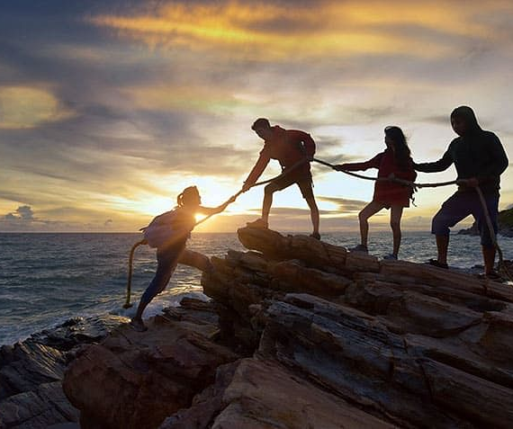
Performing Stage, Weeks 4-9
Feelings & behaviors
Students function well alone and in small groups
Understanding strengths and weaknesses
Relying on each other to support
Empathy
High commitment to course outcome
Collaborative work ethic
High levels of creativity and satisfaction

Slide 12

Adjourning Stage, Weeks 8-10
Feelings & behaviors
Grief
Appreciation
Anxiety about next steps/losing connections
Fracturing into smaller groups
Emotional withdrawal from group
Absence

Slide 13
As the Leader of Your Community…
What you can do
Understand these stages
Intervene if your class doesn’t progress
Initiate Forming by fostering connections and dialogue among students
Understand why Storming happens and how to moderate the group
Identify when Norming happens and keep the group from complacency
Celebrate Performing and empower students to self-organize
Assist with Adjourning by creating a reflective exercises or post-mortem discussion

Slide 14
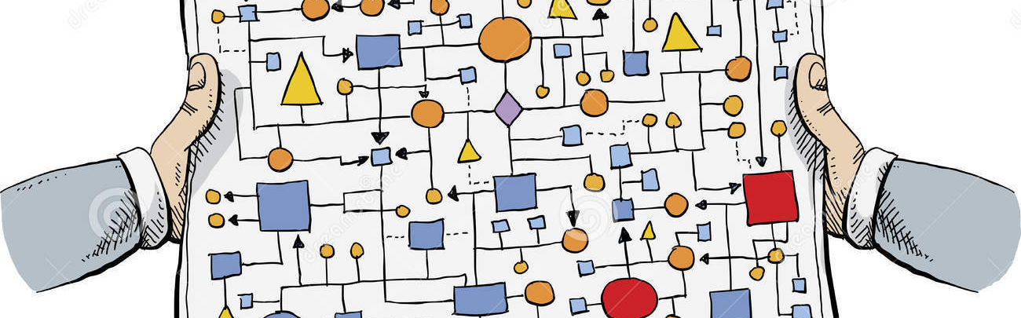
There Is No Single Seamless Process

Slide 15


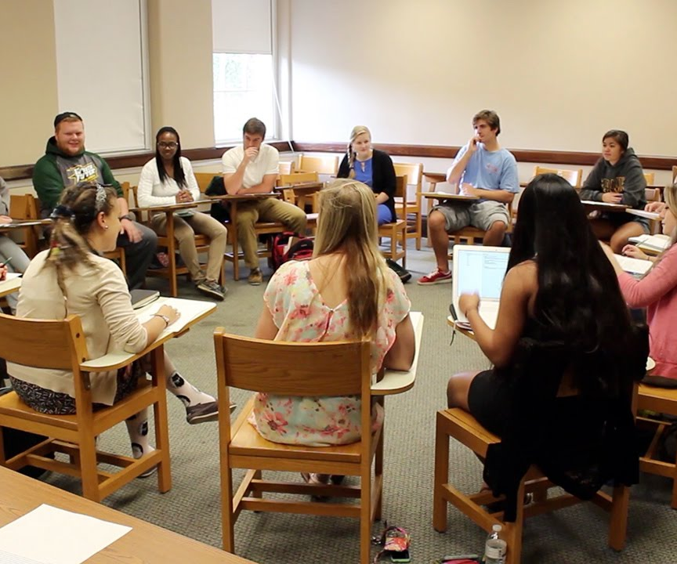
The Room Where It Happens
Every space has a leader
Every student has unspoken expectations, needs, and fears
The classroom, as an idea, may carry assumptions and connotations

Slide 16

Critique, Conflict, and the Workshop
In the learning process, conflict is normal and natural. Students adapt to information at different speeds, for different reasons, and do not share the same values or perspectives.

Slide 17
Shifting the Frame
Safe space
Brave space
Avoids conflict in favor of harmony, even if faked/inauthentic
Assumes everyone feels safe just by being present
Encourages shallow and impersonal discussion
Shuts down deeper explorations of ideas
Can require all participants share the same values and understanding of cultural norms
Requires/respects vulnerability
Acknowledges diverse lived experience
Understands fear as a challenge
Invites critical/complex thinking
Demands clear intentions
Avoids reaction in favor of reflection
Brave space points adapted from
Victoria D. Stubbs, LICSW, LCSW-C

Slide 18
I was prepared to use this time
to advocate for more “Brave Space”
awareness, but then I learned
something new along the way

Slide 19
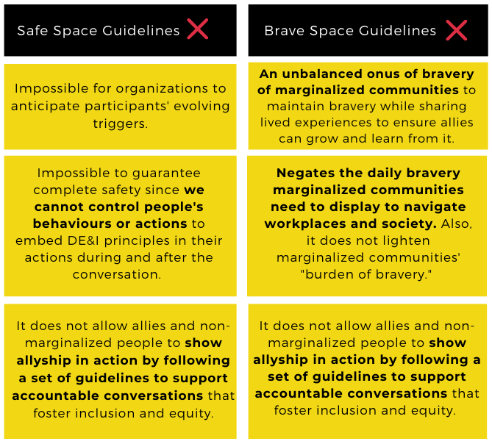
Where Safe and Brave Spaces Fall Short
New frames for inclusion
When we look at these issues from the perspective of the most burdened, vulnerable, marginalized, or silenced members of our classrooms, here are some conclusions we can draw about the experience of being in those spaces.

Slide 20
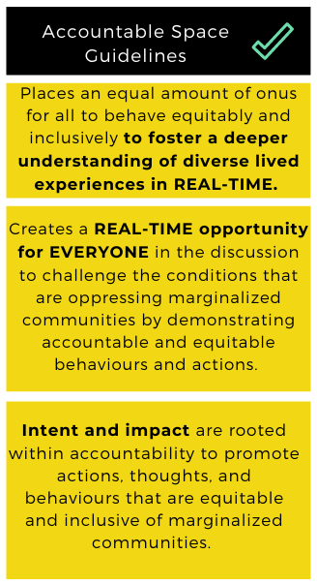
What is an Accountable Space?
Within the framing of an Accountable Space, we see greater emphasis placed on clear, shared guidelines.
Invites all community members to listen and reflect on behaviors that marginalize others, even unintentionally so.
These spaces help train thinking around inclusion and equity so that these habits can extend beyond the space and into daily life.
Accountable space information adapted from Elise Ahenkora

Slide 21
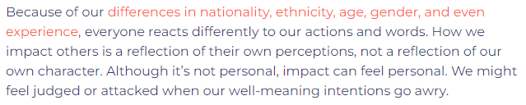
The Gulf between Intention and Impact
Source: Coach Hub
“We judge ourselves by our intentions and others by their actions.”
–Stephen Covey

Slide 22
Balancing the Factors
Assume good intent
Acknowledge impact
Reminding members of a group to assume good intent from each other is one way to diffuse conflict effectively.
This can inform how conflict is introduced to the group in preparation for resolution.
Setting the standard that all group members acknowledge their impact (often in the form of an apology) is the most critical form of accountability.
Good intent does not excuse bad behavior
Accountability should promote healing.

Slide 23
People support
what they help create

Slide 24
Tools for Building
Accountable Spaces

