Slide 1
Student Services Process Training: Policy Compliance, Reporting and Incident Management for Student Conduct and Student Grievances
Melissa Turkington
Student Rights & Responsibilities Manager
Kim Thrift
Institutional Policy & Process Analyst

Slide 2
Policy Compliance
SA507 Student Rights & Responsibilities
Outlines student conduct code
Codifies function of the SRRC
Identifies roles responsible for resolution & hearing process
Clear language in addressing behaviors and expectations
Strong due process and outcomes for students
SA508 Grievance and Dispute Resolution
for UNEX Students
Outlines grievance types
Codifies responsibilities of Student Services and key stakeholders for resolving student grievances
Guidelines for working with responsible campus offices
Strong due process and outcomes for students
Extension policies are located on the intranet. Public-facing policies are located on the website.
Notes:
Student Rights & Responsibilities Policy (SA507) and procedure (SA507.1) can be found here:
https://www.uclaextension.edu/policies

Slide 3
Reporting
Goals of Reporting
Identify and respond to risk
Determine appropriate interventions
Long-term care community connections
Centralized response and tracking
Incident Reporting Form
Student Conduct
Title IX
Threat/Suicide Assessment
Situations of Concern
Workplace Concerns
Notes:
Other uses for the incident reporting form.
Information about the BIT can be found here:
https://ucla.app.box.com/v/bit-brochure

Slide 4
Best Practices
Approach with your HEART
Hear what the student is saying
Empathize with the situation
Ask questions/assess the student’s needs
Refer to campus & community resources
Tell the appropriate campus official
Notes:
3 steps to the process. Manage, Refer, Report.
People often think of reporting as step one, but it is actually the final step in the process.
Majority of behavioral issues mitigated with proper classroom management techniques, but often taught to be subject matter experts, not teachers.

Slide 5
Dangerous Behavior Examples
Physical assault such as pushing, shoving or punching
Throwing objects
Direct communicated threat to professor, staff or another student such as: “I am going to beat you up” or “If you say that again, I will end you”
Creative writing samples that indicate urgent distress AND are different than the student’s norm
Notes:
An overwhelming majority of student behaviors are either disruptive or distracting. These behaviors are under the purview of the instructor to handle within the classroom environment. Students can not be disciplined under the code for being rude or obnoxious. It is important to set, and enforce, strong classroom behavioral expectations.
In rare cases, Dangerous behaviors should result in a call to 911. Any imminent threat or safety concern should be taken seriously and the proper emergency response staff should be called to manage the issue. Please call x3000 after calling 911 to report that 911 has been contacted. Students in distress primer

Slide 6
Referral Resources
Campus Resources
SRRC
Office of Disability Services
Title IX Office
CARE Advocates
Office of Ombuds Services
International Student Office
Financial Aid/Veterans Services
Enrollment Services
Career Services
Notes:
Community resources brochure

Slide 7
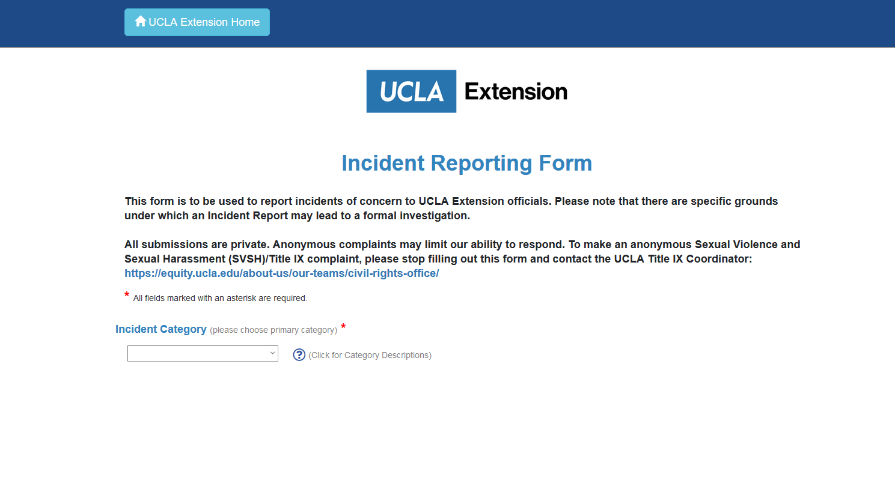
Reporting
IncidentReporting.UCLAextension.edu
Report incidents as they occur (ASAP/24hrs)
Avoid over-broadness
Speak directly to concerning behaviors
Convey facts
When in doubt, report
Consult with Student Rights & Responsibilities Center if you have questions about reporting

Slide 8
Student Rights &
Responsibilities Center
Gayley Center, 2nd floor
SRRC@unex.ucla.edu
(310) 825-0953
https://ucla.box.com/s/ex88e3fyj7zdkfmwe1a3g5fm1pjnhsxx
Notes:
Table exercises – breakout rooms

